Slide 1
UE18CS390B – Capstone Project Phase – 2
Project Progress Review #3
Project Title : PerfectCrop - The right crop for your soil
Project ID : PW22RBA01
Project Guide : Prof. Raghu B A Rao
Project Team : Akash Kumar Rao PES1201800089
Ishan Agarwal PES1201800291
Srish Srinivasan PES1201800051
Vishruth P Reddy PES1201800102

Slide 2
Outline
Abstract and Scope of the Project
Suggestions from Review – 2
Implementation Details
Project Demonstration
Test Plan and Strategy
Results and Discussion
Project Report Draft
Conclusion and Future Work
References
IEEE paper Draft
List of Targeted Conferences/Journals

Slide 3
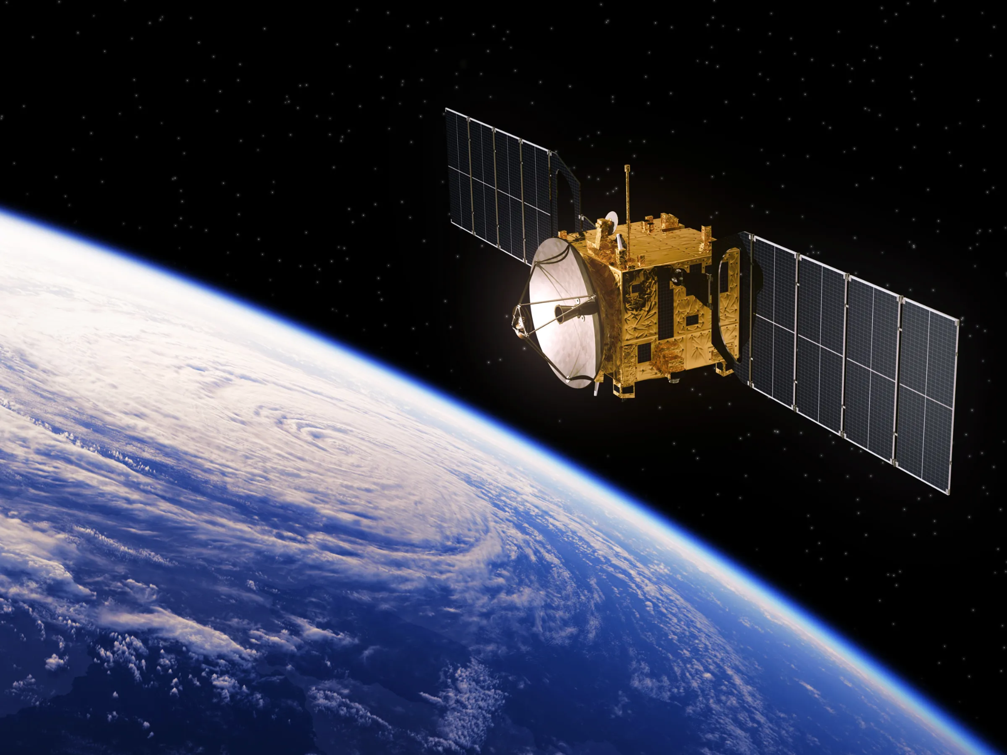
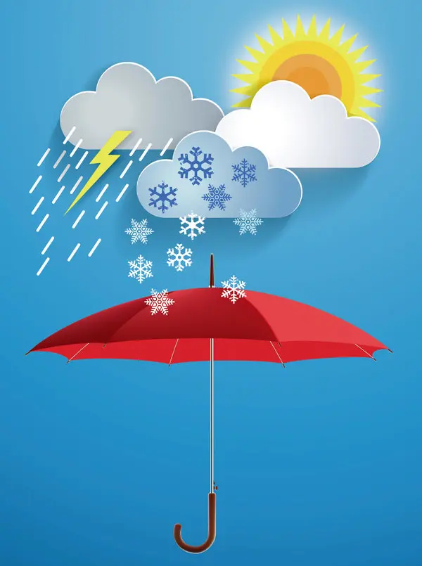
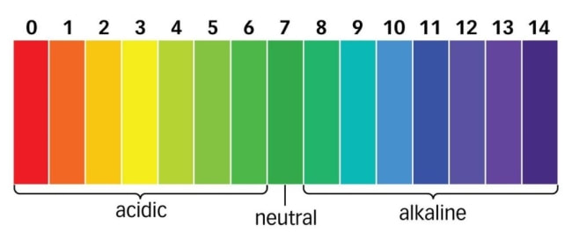
Abstract and Scope
Crop recommendation system
Parameters used -
Soil characteristics like pH
Macronutrients like Nitrogen, Phosphorus, Potassium, etc.
Weather conditions
Satellite images

Slide 4
Suggestions from Review - 2
Suggestion | Action Taken
Make a more user friendly website | Changes to UI made,site made more appealing and adaptive to any device
Run models with all indices and draw comparisons | Models run with all chosen indices , with detailed comparisons made on accuracy on all districts
Find more suitable indices | NDWI also added to suitable indices and paper found supporting it

Slide 5
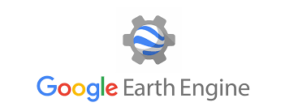
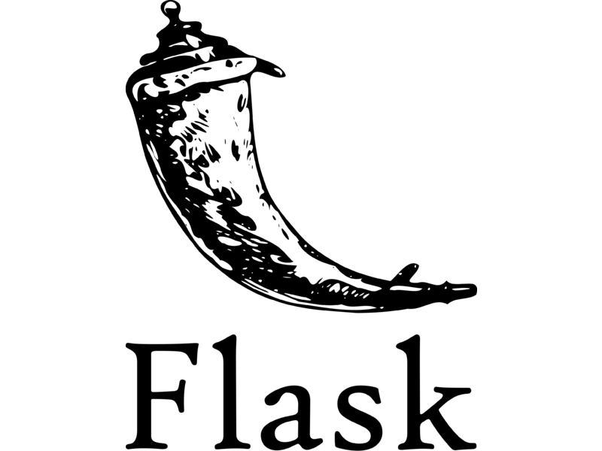


Implementation Details
Module | Technologies Used
Machine Learning Model | Python3 (pandas, numpy, sklearn, tensorflow)
Satellite Images and Indices | Google Earth Engine, Python3(geemap)
Website Backend | Flask
Website Front End | HTML, CSS, JS, Bootstrap

Slide 6
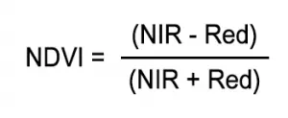
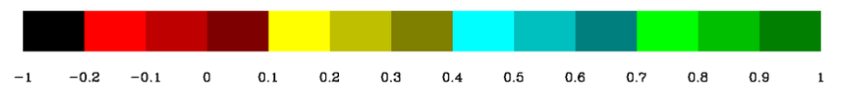
Code Explanation
NDVI (normalized difference vegetation index) is one such index which helps in understanding greenness where the higher value indicates more greenness(high vegetation areas,healthy plants) and lower indicates barren areas(and withering plants).

Slide 7
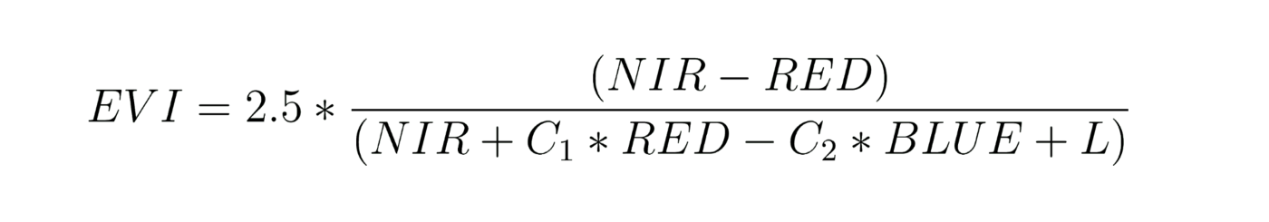
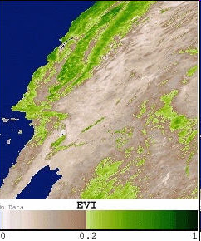
Code Explanation
EVI (Enhanced Vegetation Index) is an optimized vegetation index which works like NDVI providing greenness measure but also provides some correction for noise and atmospheric conditions with better results in areas of high density of vegetation.
Key Features:-
Corrected NDVI
Accounts for noise and atmospheric conditions
Better results in high density vegetation areas
C1(=6) is the red correction factor
C2(=7.5) is the blue correction factor
L(=1) is the canopy background correction factor

Slide 8
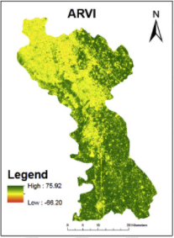
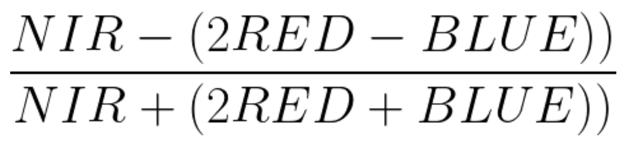
Code Explanation
ARVI (Atmospherically Resistant Vegetation Index) is a more refined form of NDVI which amounts for atmospheric correction due to pollutants(aerosol like soot,fog etc).It also provides better results as it takes into account the topology / terrain of the region .This makes it more effective for mountainous regions
Key Features:-
Corrected NDVI
Accounts for pollutants in air
To some extent accounts for terrain/topology
ARVI =

Slide 9
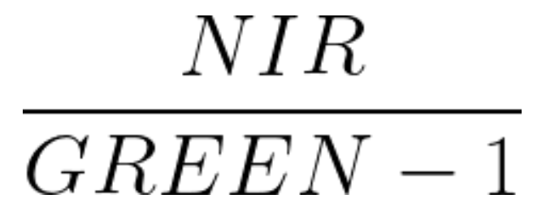
Code Explanation
GCI (Green Chlorophyll Index) is the measure of the chlorophyll in leaves.This states the health of the plant / crop and can thus be good for measuring yield.Since it deals directly with the chlorophyll content it can be used in comparing yield before and after using pesticides , accounting for environmental stress on plants ,etc.
Key Features:-
Chlorophyll content detection
Useful for accounting for pesticide/chemical effect on plants
Can account for environmental stress
GCI =

Slide 10
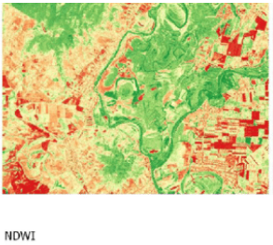
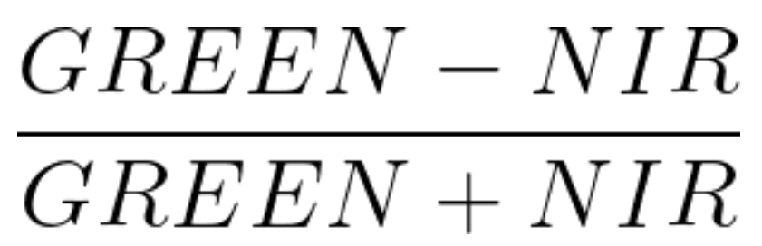
Code Explanation
NDWI (Normalized Difference Water Index) is an index which helps to determine the crop condition by accounting for moisture content in plants and crops.This proves helpful for drought prone areas and water stress in vegetation.
Key Features:-
Measures leaf moisture
Can account for droughts and plant moisture requirements
NDWI =

Slide 11
Project Demonstration

Slide 12
Test Plan and Strategy
Provide,
Testing activities that are carried out along with timeline.
What are the test methods followed? and Why?
(Example) – Functional Testing (Unit, Integration,…)
Non – Functional Testing (Performance, Security,…)
What is the test environment? (Explain the role of each member in the team)
Benefits of this approach & are there any drawbacks?
Test tools used? Automated test tools? Open-source tools?
Note:
Appropriate modifications can be done for Research Projects
Add as many slides as required

Slide 13
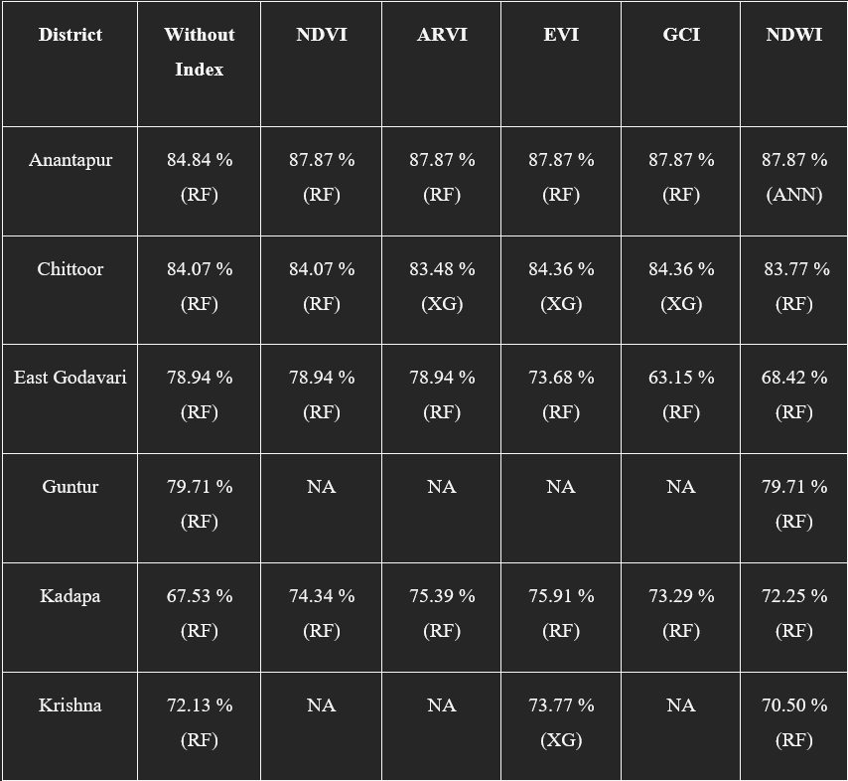
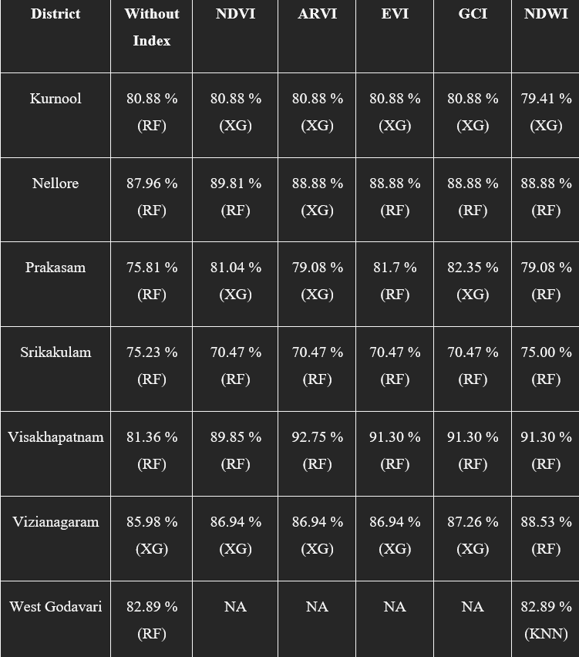
Results and Discussion

Slide 14
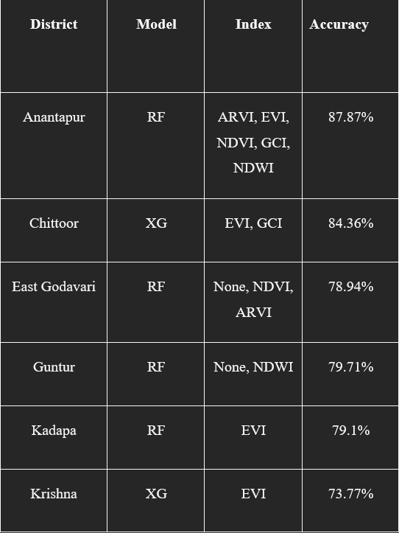
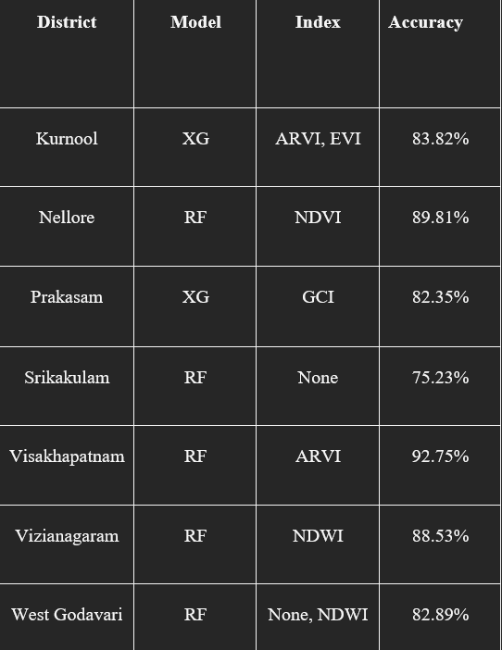
Results and Discussion

Slide 15
Timeline – Update on Tasks
Project completion status - 95% (Functional Testing to be done on website after hosting )
Project Report exhibition
Project Report completion Status

Slide 16
Conclusion
A fairly credible model developed for crop recommendation.
Research work done to understand usability of vegetation indices with other factors

Slide 17
Future work
Better indices and combination for best accuracy achievable.
Messaging based service for areas with no internet access.
Economy based models with crop prices taken in account.
All in one IOT device which displays the crop to be grown.

Slide 18
References
New Paper Used for Research
Petersen, L.K., 2018. Real-time prediction of crop yields from MODIS relative vegetation health: A continent-wide analysis of Africa. Remote Sensing, 10(11), p.1726.

Slide 19
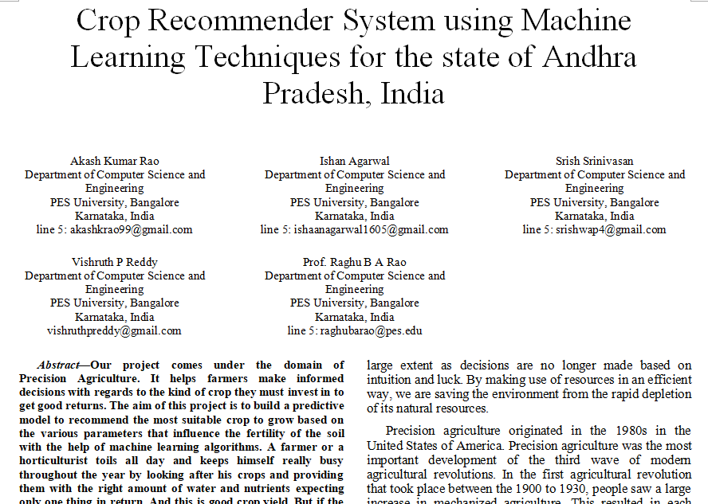
IEEE Draft
List of conferences/journals targeted -

Slide 20
Thank You

